Slide 1
Multi-Layer Perceptron (MLP)

Slide 2
What is MLP?
• MLP stands for Multi-Layer Perceptron
• Type of Artificial Neural Network (ANN)
• Contains Input, Hidden and Output layers
• Used for classification and regression problems

Slide 3
Structure of MLP
• Input Layer – Receives features
• Hidden Layer(s) – Performs computation
• Output Layer – Produces prediction
• Fully connected feedforward network
Learns using backpropagation

Slide 4
Why Hidden Layers?
• Learn non-linear relationships
• Perform feature transformation
• Capture complex patterns

Slide 5
Mathematical Model of a Neuron
z = w1x1 + w2x2 + ... + wnxn + b
a = f(z)
• w = weights
• b = bias
• f(z) = activation function

Slide 6
Activation Functions
• Sigmoid
• ReLU
• Tanh
• Softmax (for multi-class classification)

Slide 7


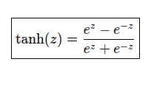
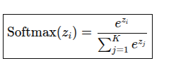
Sigmoid
output range (0, 1)
RELU(Rectified Linear Unit) -
The function returns z if z is greater than 0. If z is less than or equal to 0, the function returns 0.
Tanh -
output range between -1 and 1.
Softmax
Output range - (0, 1) (for each class)

Slide 8
Forward Propagation
• Input multiplied by weights
• Add bias
• Apply activation function
• Pass output to next layer

Slide 9
Loss Function
Measures difference between predicted and actual output
• Binary Cross Entropy
• Categorical Cross Entropy
• Mean Squared Error (MSE)

Slide 10


Slide 11
MLP - Back Propagation
BP neural network has two phases: Forward Pass and Backward Pass
Forward pass phase: computes ‘functional signal’, feed forward propagation of input pattern signals through network
For each training instance, the algorithm feeds it to the network and computes the output of every neuron in each consecutive layer
Backward pass phase: computes ‘error signal’, propagates the error backwards through network starting at output units (where the error is the difference between actual and desired output values)
It then proceeds to measure how much of these error contributions came from each neuron in the previous hidden layer—and so on until the algorithm reaches the input layer.
This reverse pass efficiently measures the error gradient across all the connection weights in the network by propagating the error gradient backward in the network (hence the name of the algorithm).

Slide 12
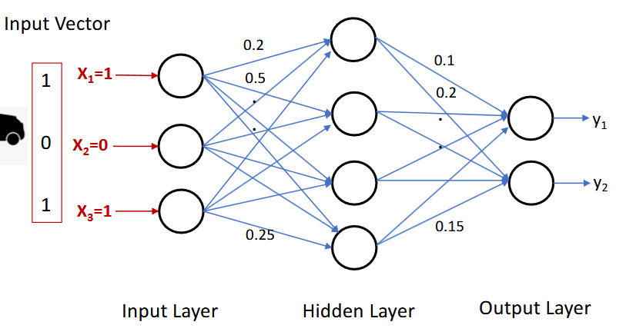
Forward Pass

Slide 13
Backward Propagation
With gradient descent, we move the weights to a position where the cost is minimum.
Back propagating the network from the output layer to the input layer and calculate the gradient of the cost function with respect to all the weights between the output and the input layer.
After calculating gradients, old weights can be updated using weight update rule:
This whole process of back propagating the network from the output layer to the input layer and updating the weights of the network using gradient descent to minimize the loss is called back propagation.

Slide 14
Gradient Descent is an optimization algorithm used to, minimize the loss (error) by updating weight. It moves weights in the direction of steepest decrease of the loss function.
Gradient tells direction to reduce error. How much the loss (error) changes if we slightly change a weight.
If output is near 0 or 1 → derivative very small → vanishing gradient problem.

Slide 15
Backward Propagation
How do we update the weights?
After calculating gradients, old weights can be updated using weight update rule:

Slide 16
Back Propagation Algorithm

Slide 17
MLP Algorithm

Slide 18
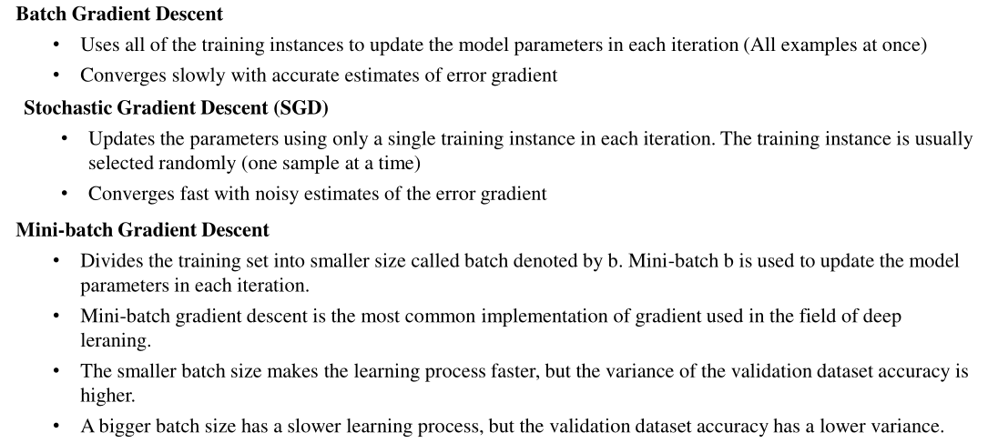
Gradient Descent ways

Slide 19
Example:1

Slide 20
Example:1

Slide 21
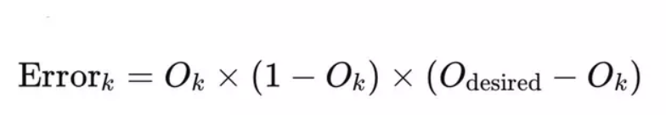
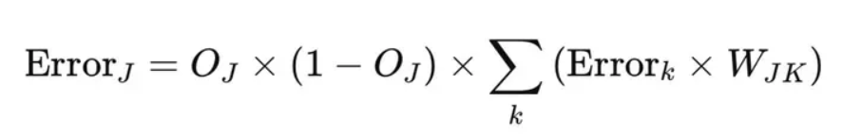
Error at output neuron is calculated as
Error at hidden layer neurons are calculated as

Slide 22

Bias update
New bias= old bias +ηδ
ηδ - learning rate x error
Weight update
δj​​ is the error term for each unit,
η is the learning rate.
O is the output at the particular neuron

Slide 23
Example:1(For example,only weight update shown. Bias also need to update)

Slide 24
Example:1

Slide 25
Example:1

Slide 26
Example:1

Slide 27
Example:1

Slide 28
Multi layer Perceptron – Example 2
In this case, we have been given a multi-layer perceptron network with the input layer, one hidden layer, and the output layer. In this case, the input layer has four neurons, the hidden layer has two neurons. You can notice here, X1, X2, X3, X4 are the input layer neurons, and X5 and X6 are the hidden layer neurons, and X7 is the output layer neuron. In this case, X0 is a bias with respect to the hidden layer neurons as well as the output layer neuron. In this case, we need to train the multi-layer perceptron by updating the weights as well as the biases in the network. The learning rate given to us is 0.8 in this case, and the inputs are X1, X2, X3, X4, which are 1, 1, 0, 1, respectively, and the desired output, that is, the target output in this case, is one. That is what is expected from this particular multi-layer perceptron network. Along with this, the weights are also given to us.

Slide 29
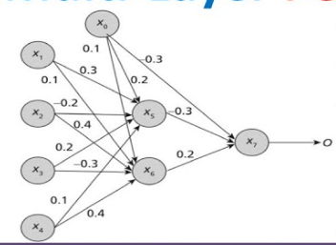

Slide 30
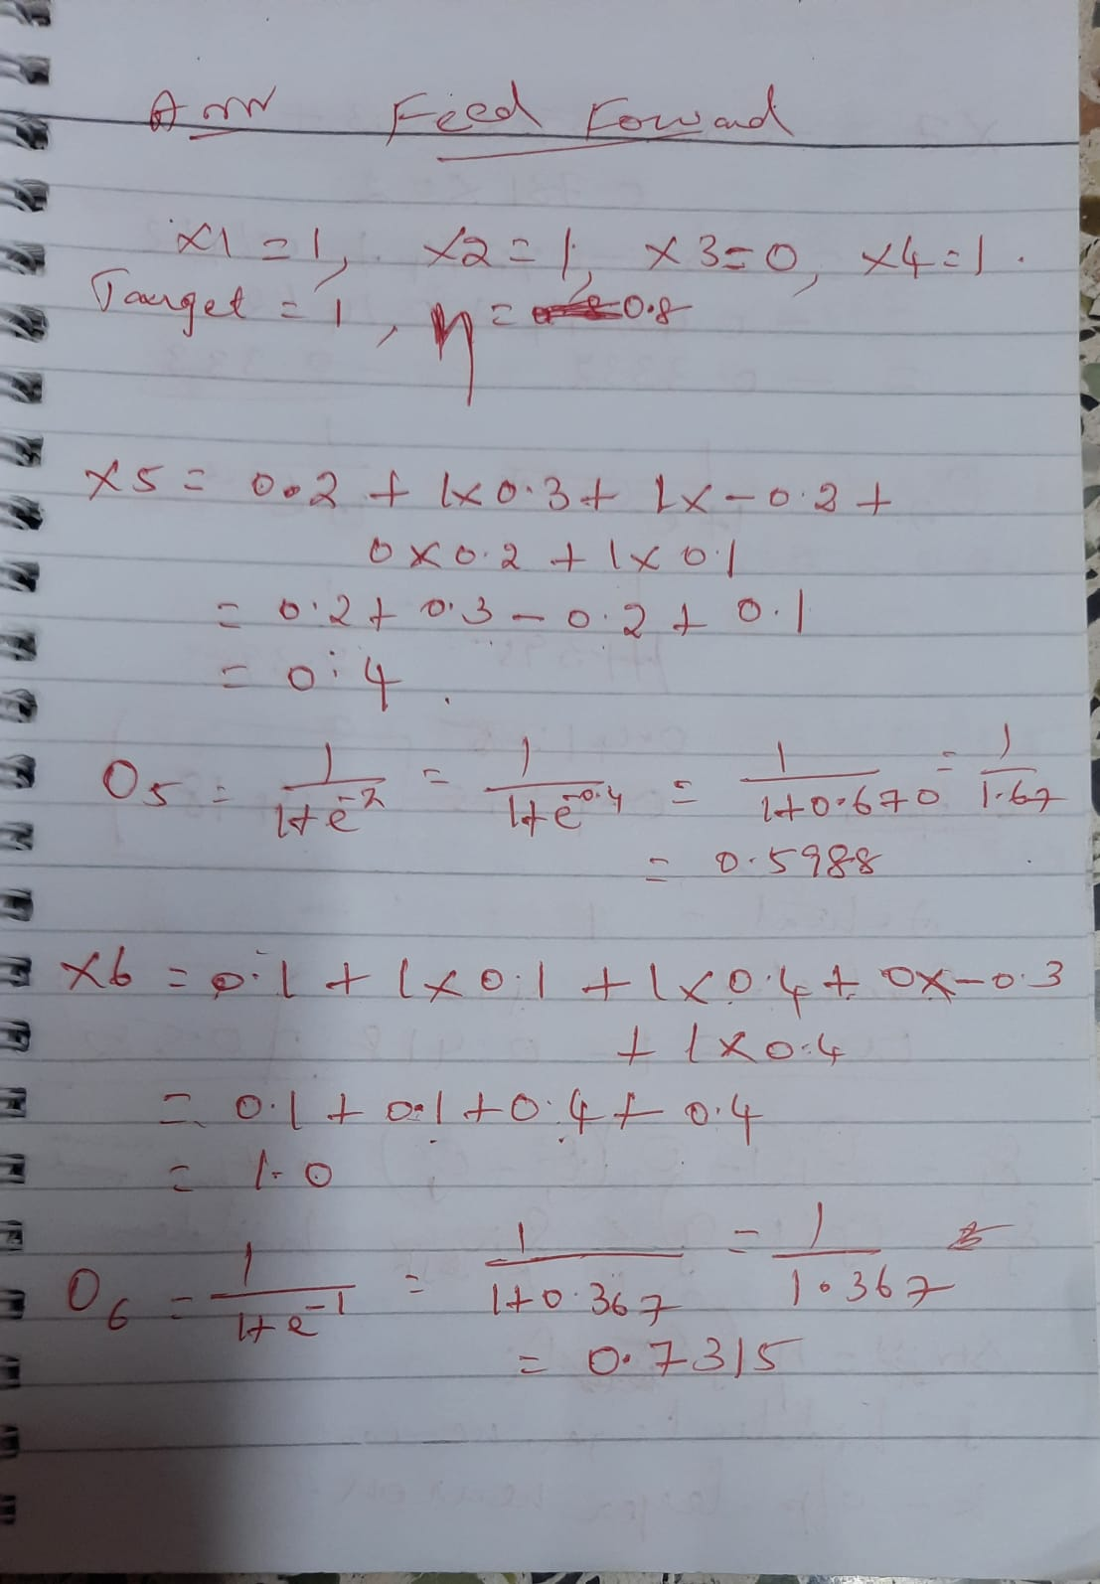

Slide 31
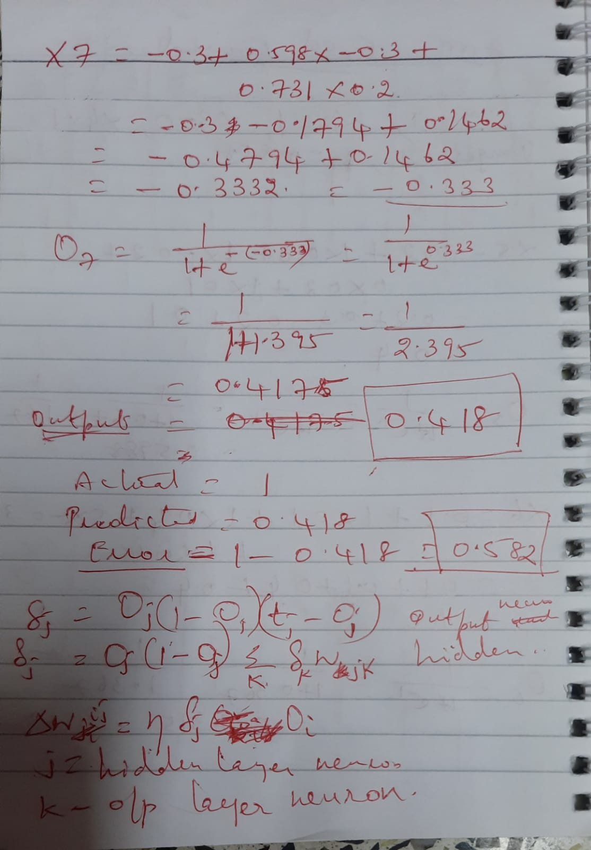

Slide 32
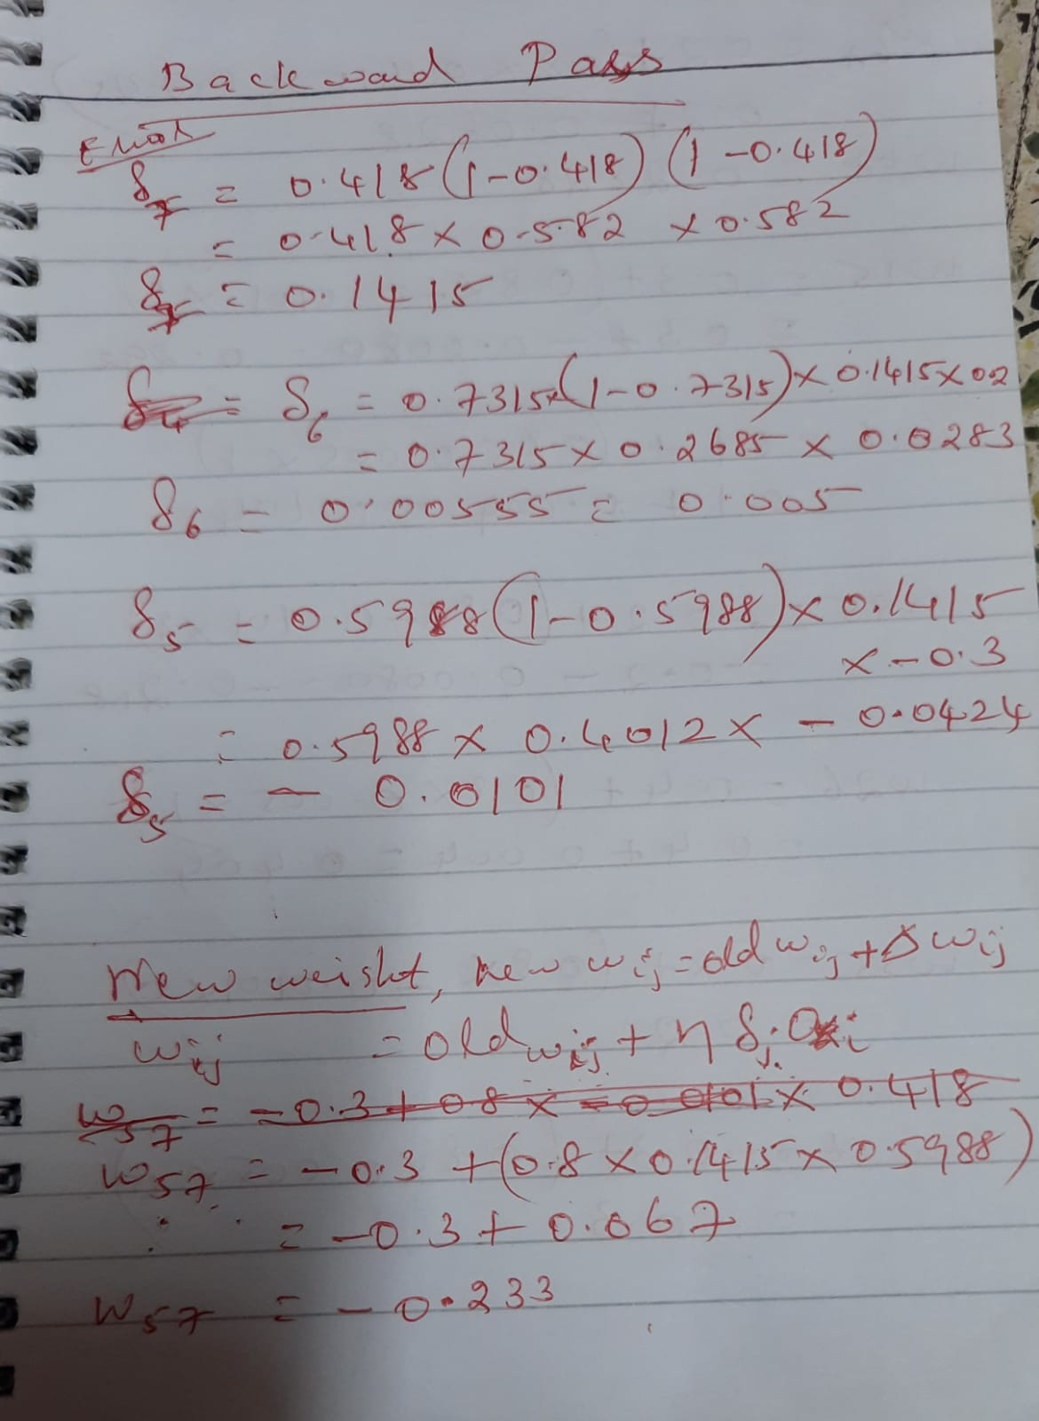

Slide 33
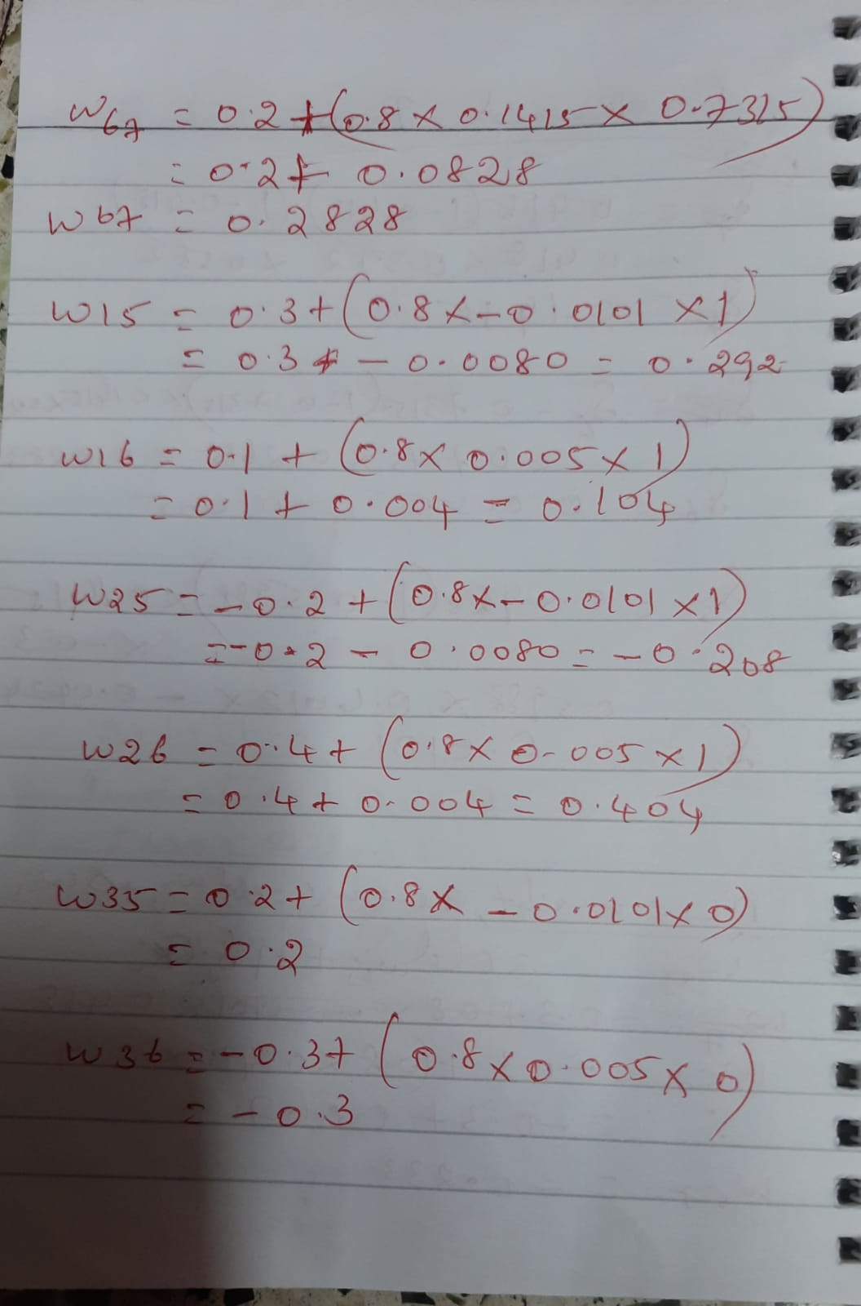

Slide 34
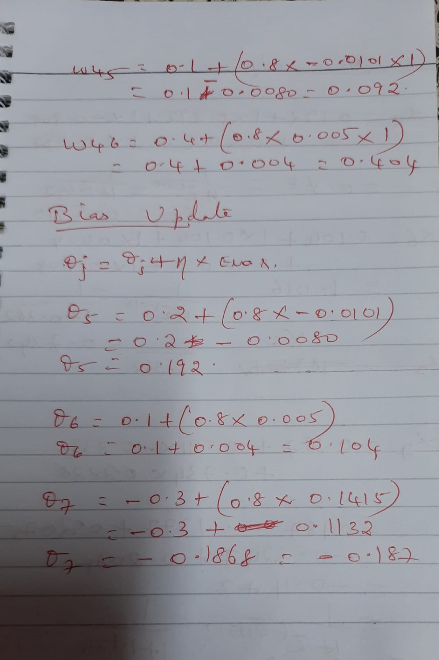

Slide 35
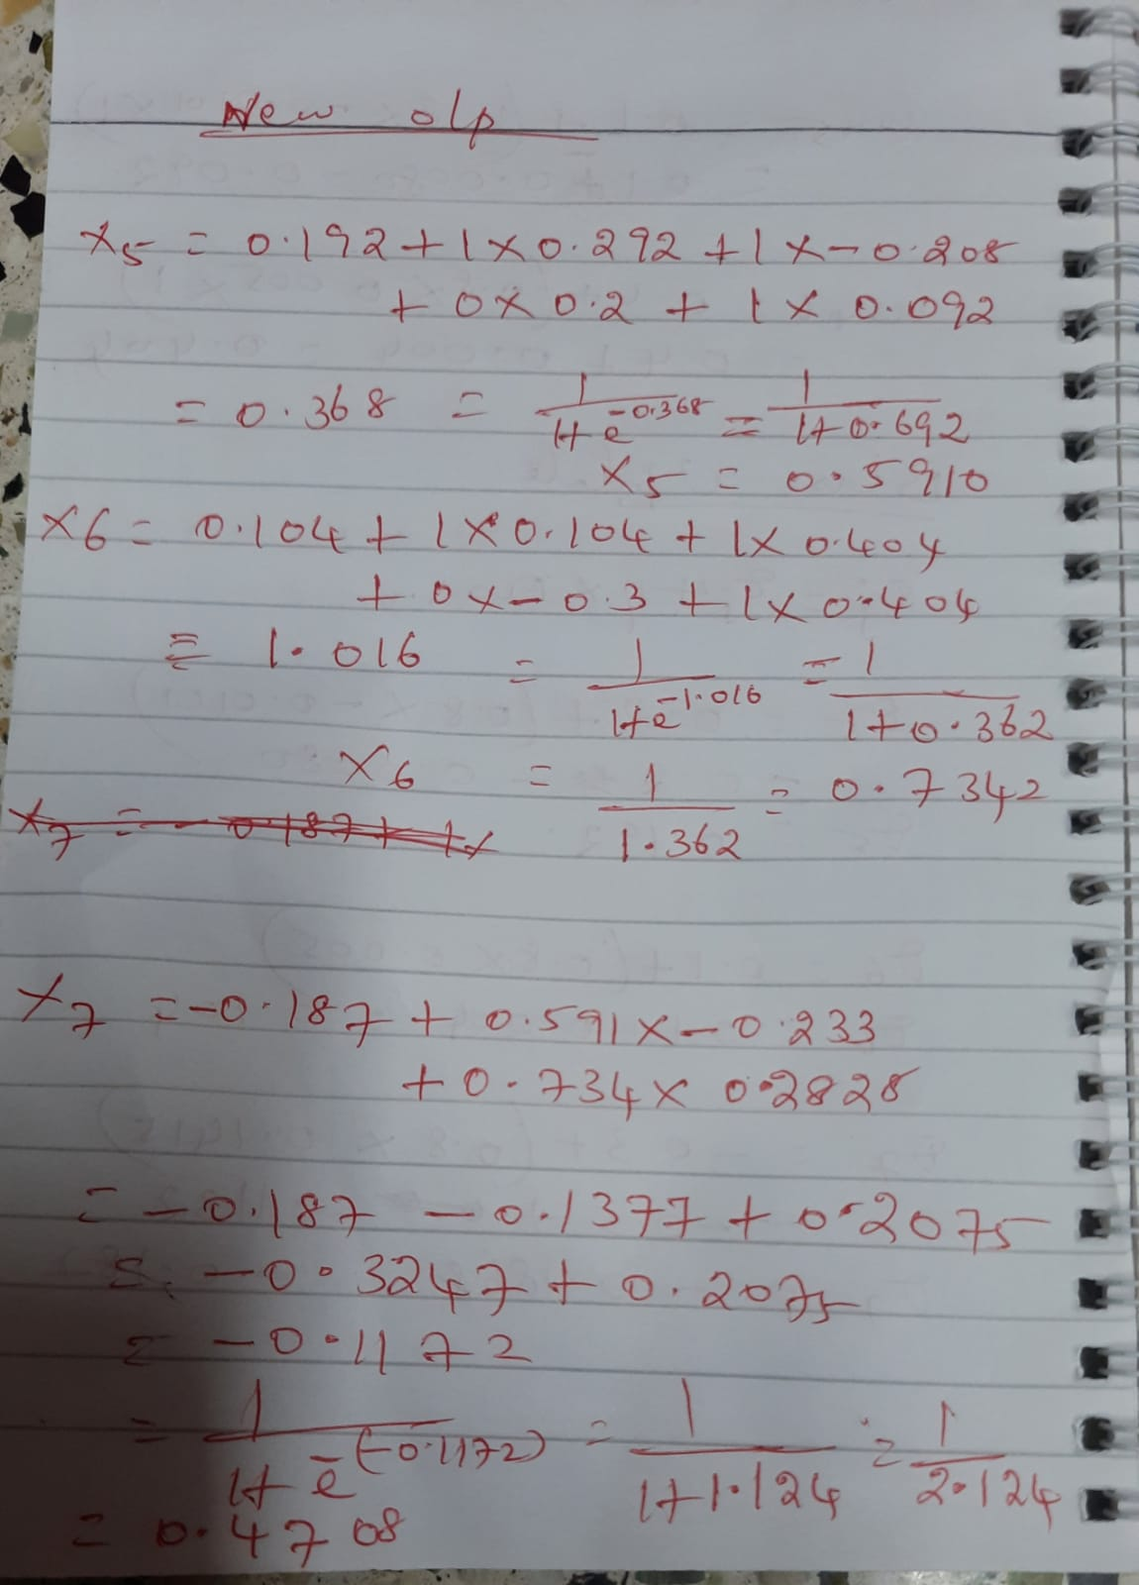

Slide 36
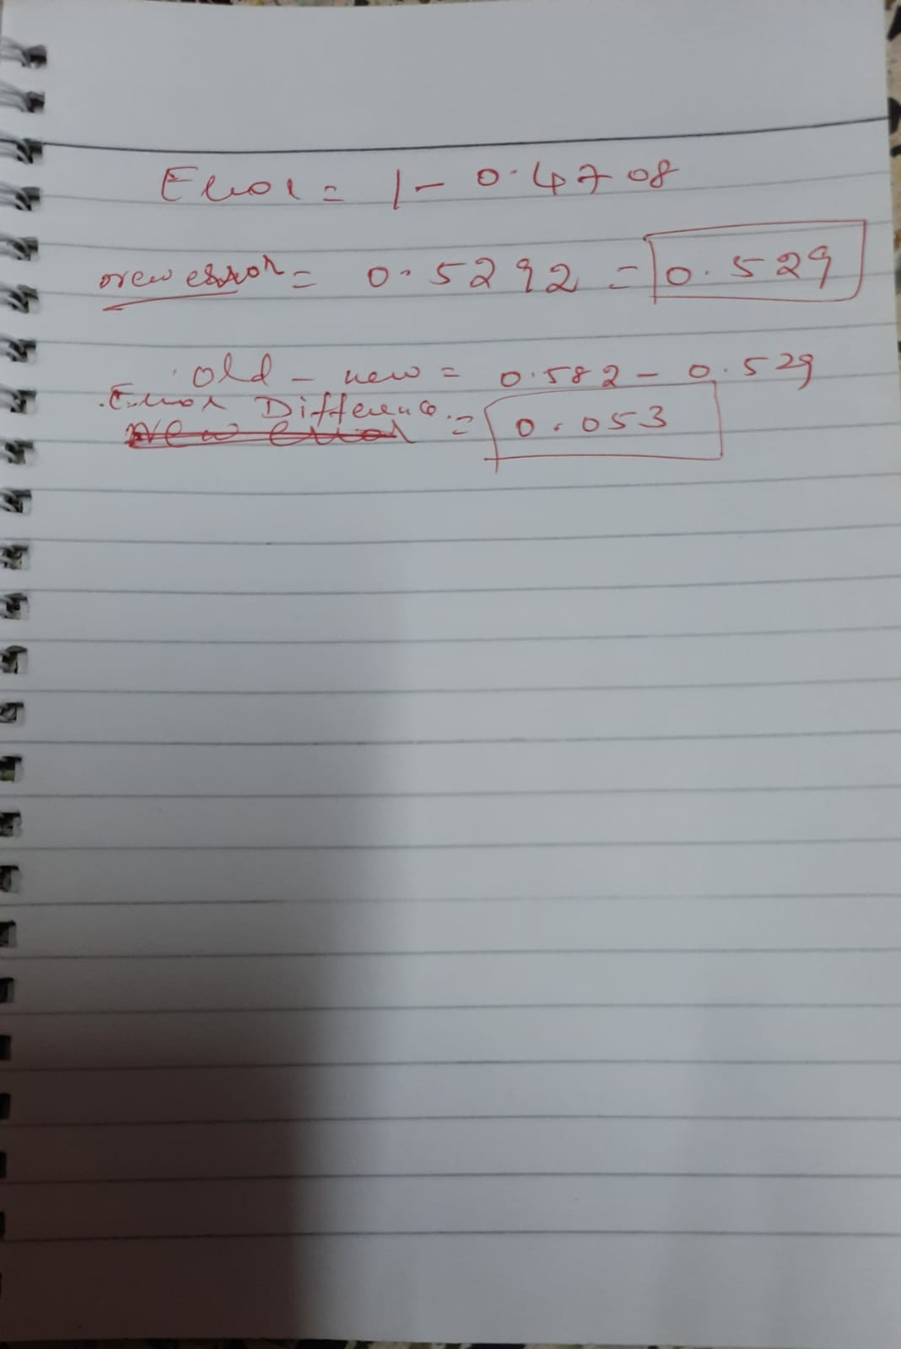

Slide 37
Applications of MLP
• Image classification
• Speech recognition
• Text classification
• Medical diagnosis
• Fraud detection

Slide 38
Advantages
• Handles non-linear data
• Flexible architecture
• Works for classification and regression

Slide 39
Limitations
• Requires large data
• Computationally expensive
• Risk of overfitting
• Vanishing gradient problem

